Slide 1





EduChain Vote
Rishika Banerjee:16010122012 & Aarushi Savla:16010123812
Blockchain-Based Decentralized Voting System for Class Representative Elections
A Comprehensive Architectural Overview and Research Foundation
Academic Rigor
Security & Integrity
Grounding the solution in established research and frameworks.
Leveraging blockchain's immutability for tamper-proof elections.
Technical Stack
Transparency
Modern, robust technologies for implementation and scalability.
Making the electoral process fully auditable and verifiable.

Slide 2

Title Slide — Introduction to EduChain Vote
A Decentralized Approach to Academic Governance
Welcome to our presentation on EduChain Vote, a blockchain-based decentralized voting platform developed to ensure secure, transparent, and tamper-proof elections within academic institutions.
This system is designed not only to facilitate elections but also to serve as an educational showcase for decentralized application (DApp) development and blockchain utility in civic processes.
Developed by: Rishika Banerjee & Aarushi Savla
Date of Review: 21 October 2025
Ethereum
React
Hardhat
MetaMask

Slide 3

Motivation & Background: Addressing the Flaws of Traditional Systems
In most schools and colleges, critical processes like class representative elections are still conducted through traditional paper-based or centralized digital systems. These mechanisms, while familiar, inherently possess vulnerabilities that compromise the integrity of the democratic process.
“Conventional voting mechanisms suffer from cost, security, and transparency issues, making them prone to manipulation and distrust.”
— El Kafhali (2024)
The core problem lies in the single point of failure and the reliance on a trusted central authority, which can be inefficient, costly, and susceptible to fraud.
Visual representation of a traditional ballot counting process, highlighting manual intervention and lack of immediate transparency.

Slide 4
Problem Definition: The Hurdles of Centralized Elections
We identify five critical shortcomings in current class representative election methods that EduChain Vote is specifically designed to resolve:
Lack of Transparency
Verification Challenges
Security Vulnerabilities
Results tabulation and vote counting processes are often opaque, forcing participants to rely solely on the organizing body's report without independent verification.
Verifying that every valid vote was counted and that no fraudulent votes were introduced is resource-intensive and often retrospective, undermining real-time trust.
Centralized databases are prime targets for cyberattacks or insider tampering, risking the integrity of the entire electoral dataset.
Centralized Authority
Limited Auditability
Excessive control rests with a single administrative entity, creating potential for bias, veto power, and a single point of failure.
The lack of a cryptographic trail makes complete and indisputable auditing difficult, especially regarding the immutability of the final tally.

Slide 5
Research Foundation: Blockchain as the Trust Anchor
Based on the work of S. El Kafhali (2024), blockchain technology provides a strong, decentralized foundation to overcome these pervasive voting challenges through its inherent properties.
Challenge in Traditional Systems
Blockchain Capability
Blockchain Advantage
Data Tampering/Manipulation
Cryptographic Hashing & Linked Blocks
Immutability: Once recorded, data cannot be altered.
Lack of Trust in Authority
Distributed Ledger Technology (DLT)
Transparency: All transactions are visible to all participants.
Centralized Control
Peer-to-Peer Network Structure
Decentralization: No single entity controls the voting outcome.
No Cryptographic Verification
Smart Contracts and Digital Signatures
Cryptographic Proofs: Ensuring voter authenticity and vote integrity.
Reference: El Kafhali, S. (2024) – Blockchain-Based Electronic Voting System: A Conceptual Framework and Proof-of-Concept Implementation.

Slide 6

Project Objective: Implementing Secure and Educational Governance
Our overarching goal is to design a secure, transparent, and educationally valuable blockchain-based voting system specifically tailored for student elections.
Eliminate Central Authority
Remove the dependency on manual, error-prone counting and the potential for unilateral decision-making by placing election logic on the smart contract.
Enable Verifiable Results
Provide every student with the ability to publicly verify that their vote was cast correctly and included in the final, mathematically enforced tally.
Promote Blockchain Literacy
Use the platform as an interactive, real-world case study to teach students about DApps, smart contracts, and decentralized governance principles.

Slide 7
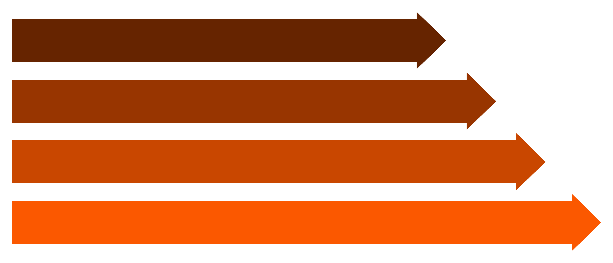
Overview of EduChain Vote: The Decentralized Workflow
EduChain Vote operates by ensuring every vote is treated as a secure transaction. This linear flow guarantees integrity from voter initiation to final tally:
Students Vote
Smart Contract
Record on Blockchain
Admin Dashboard
Narration Summary: EduChain Vote works by recording every vote as a blockchain transaction verified through a smart contract. The smart contract rigorously enforces the "one-vote-per-student" rule, guaranteeing complete transparency, and ensuring that all election records are immutable and instantly auditable by all stakeholders. The Admin Dashboard serves only as a read-only interface to present the results confirmed by the network.

Slide 8
System Architecture: Three Interacting Layers
The architecture of EduChain Vote is divided into three distinct, yet deeply integrated, layers to maximize security, usability, and operational reliability.
Frontend (Presentation Layer)
Built with React and styled using Tailwind CSS. This layer focuses on providing a secure, intuitive, and accessible user interface for students to cast their votes and view election results.
Blockchain Layer (Logic & Persistence)
The core logic is written in Solidity and deployed via Hardhat. This layer manages the voter registry, candidate lists, and the immutable counting mechanism enforced by the smart contract.
Interaction Layer (Communication)
Facilitates communication between the frontend and the blockchain network. Web3.js is used for method calls, and MetaMask provides secure, decentralized identity and transaction signing.
This layered approach ensures that business logic is separated from presentation, residing securely on the decentralized network.

Slide 9

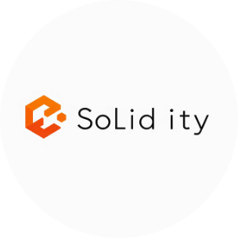




Technology Stack: A Modern DApp Foundation
The project uses a modern full-stack setup optimized for blockchain applications, ensuring reliability, speed, and scalability. Each component plays a vital role in delivering a production-ready system.
React.js – Frontend
Solidity – Smart Contracts
Hardhat – Testing & Deployment
Web3.js – Blockchain Interaction
A robust library for building dynamic, single-page user interfaces, ensuring a fast and responsive voting experience.
The object-oriented language for writing the secure, verifiable, and immutable logic that governs the entire election process on the Ethereum Virtual Machine (EVM).
A professional development environment used for writing and running comprehensive tests, debugging, and deploying the smart contracts onto the network.
The essential library used to connect the React application to the Ethereum blockchain, allowing users to send transactions and read chain data.
MetaMask – Wallet Integration
Tailwind CSS – UI Framework
Serves as the secure digital wallet for users, managing their decentralized identity and signing the transactions (votes) with their private keys.
A utility-first CSS framework enabling rapid, consistent, and highly customized styling for the modern and accessible user interface.

